Slide 1
Last Class!
Revisit interactions + Intro to Poisson Regression

Slide 2
Announcements
Do you all get requests for the formal course evaluations?
Remaining grading
Homework 4, 5, and 6 redos
Project Analysis, Report, and Presentation
Anything I’m missing?

Slide 3
Class 17 Learning Objectives
Not as formal today:
Calculate odds ratios for variables (categorical x continuous) involved in interactions
If we want, we can look at categorical x categorical and continuous x continuous
Run and interpret a simple Poisson Regression

Slide 4
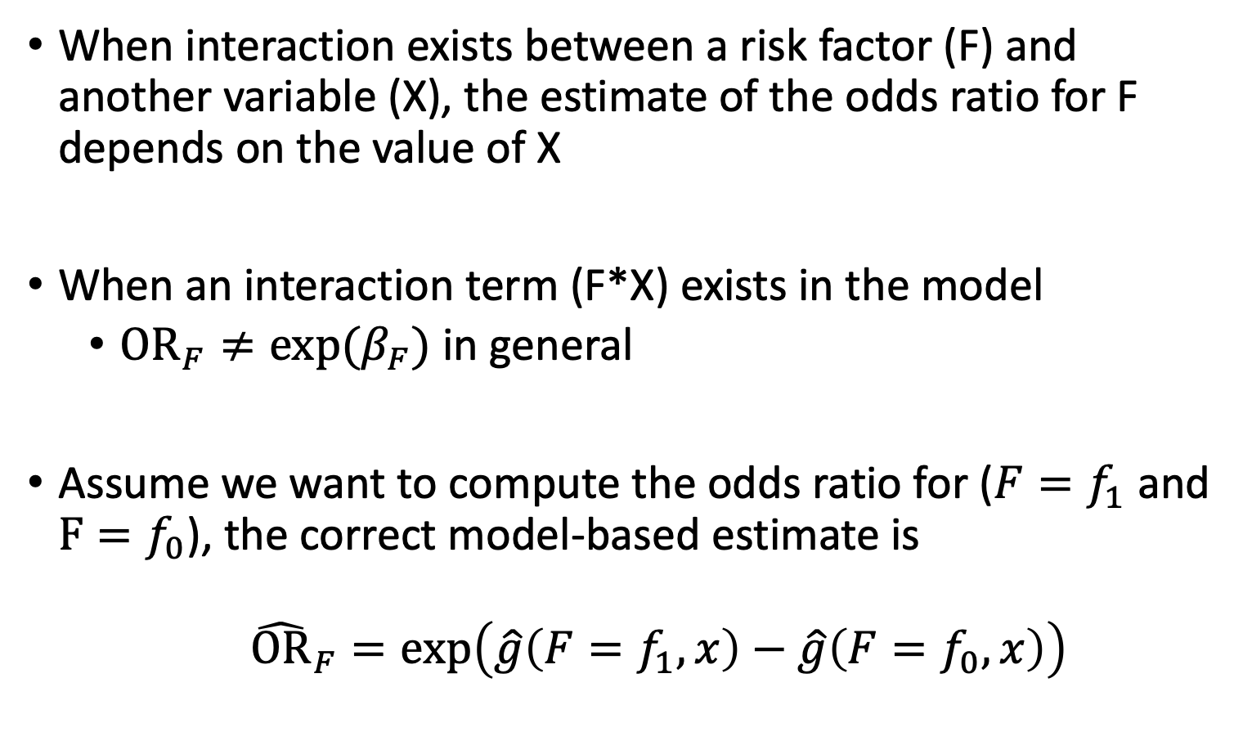
Odds Ratio in the Presence of Interaction (I)
When interaction exists between a risk factor (F) and another variable (X), the estimate of the odds ratio for F depends on the value of X
When an interaction term (F*X) exists in the model
$OR_{F}≠exp⁡(β_{F})$ in general
Assume we want to compute the odds ratio for ($F=f_{1}$ and $F=f_{0}$), the correct model-based estimate is
${\hat{OR}}_{F}=\exp\left(\hat{g}\left(F=f_{1},x\right)−\hat{g}\left(F=f_{0},x\right)\right)$
Originally from Class 9 Notes

Slide 5
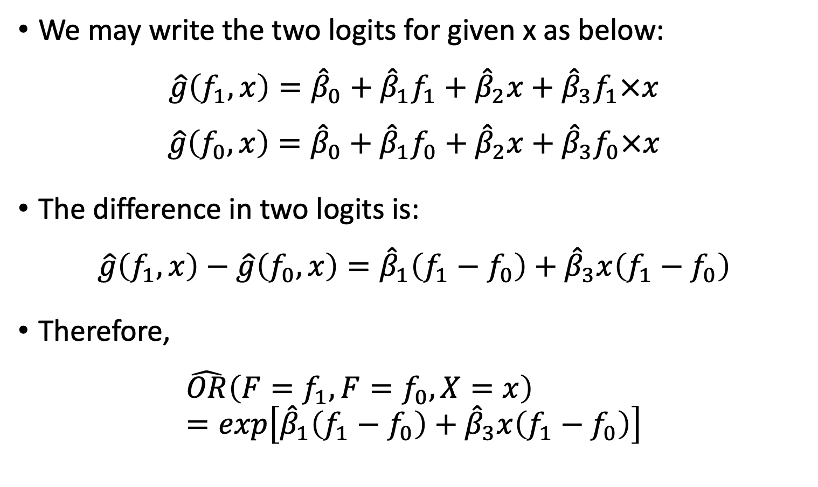
Odds Ratio in the Presence of Interaction (II)
We may write the two logits for given x as below:
$$\hat{g}\left(f_{1},x\right)={\hat{β}}_{0}+{\hat{β}}_{1}f_{1}+{\hat{β}}_{2}x+{\hat{β}}_{3}f_{1}×x$$
$$\hat{g}\left(f_{0},x\right)={\hat{β}}_{0}+{\hat{β}}_{1}f_{0}+{\hat{β}}_{2}x+{\hat{β}}_{3}f_{0}×x$$
The difference in two logits is:
$$\hat{g}\left(f_{1},x\right)−\hat{g}\left(f_{0},x\right)={\hat{β}}_{1}\left(f_{1}−f_{0}\right)+{\hat{β}}_{3}x\left(f_{1}−f_{0}\right)$$
Therefore,
$$\hat{OR}\left(F=f_{1},F=f_{0},X=x\right)=exp\left[{\hat{β}}_{1}\left(f_{1}−f_{0}\right)+{\hat{β}}_{3}x\left(f_{1}−f_{0}\right)\right]$$
Originally from Class 9 Notes

Slide 6
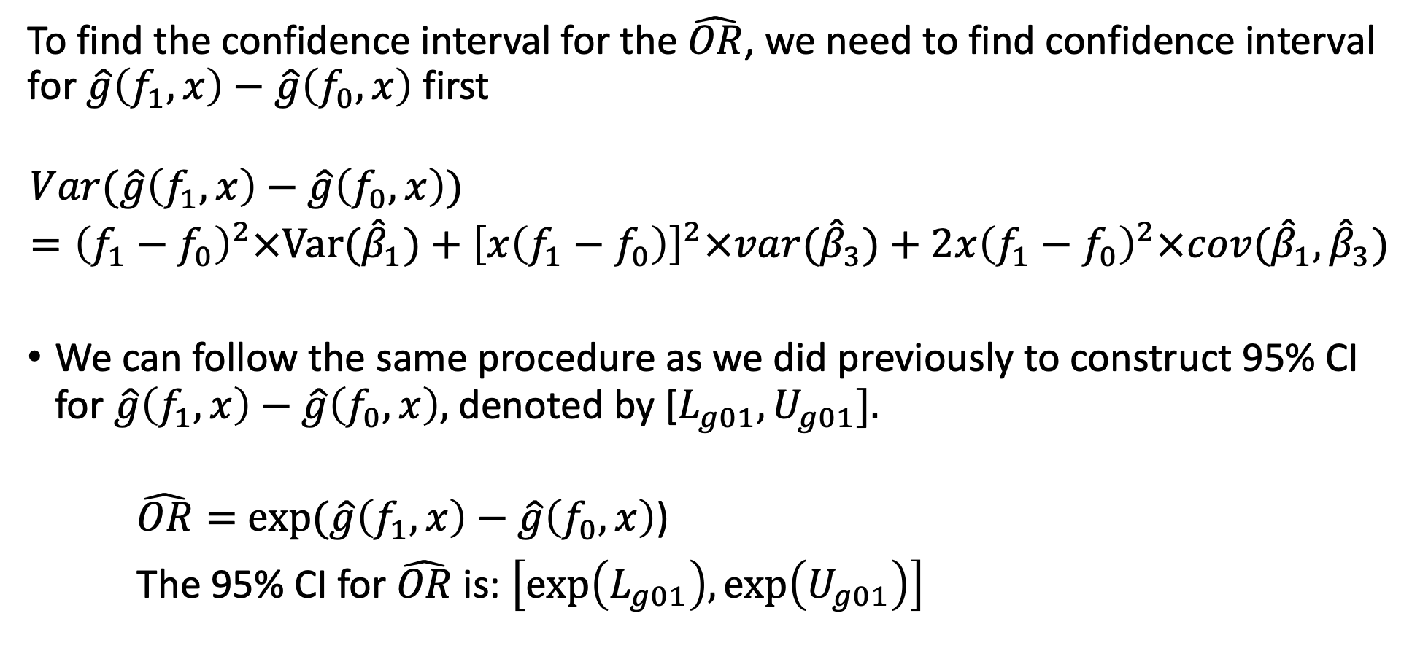
Odds Ratio in the Presence of Interaction (III)
To find the confidence interval for the $\hat{OR}$, we need to find confidence interval for $\hat{g}\left(f_{1},x\right)−\hat{g}\left(f_{0},x\right)$ first
$$Var(\hat{g}\left(f_{1},x\right)−\hat{g}\left(f_{0},x\right))={\left(f_{1}−f_{0}\right)}^{2}×Var({\hat{β}}_{1})+{\left[x\left(f_{1}−f_{0}\right)\right]}^{2}×var({\hat{β}}_{3})+2x{\left(f_{1}−f_{0}\right)}^{2}×cov({\hat{β}}_{1},{\hat{β}}_{3})$$
We can follow the same procedure as we did previously to construct 95% CI for $\hat{g}\left(f_{1},x\right)−\hat{g}\left(f_{0},x\right),$denoted by [$L_{g01}, U_{g01}].$
$\hat{OR}=$ $exp⁡(\hat{g}\left(f_{1},x\right)−\hat{g}\left(f_{0},x\right)$)
The 95% CI for $\hat{OR}$ is: $\left[exp\left(L_{g01}\right),\exp\left(U_{g01}\right)\right]$
Originally from Class 9 Notes

Slide 7
Example: GLOW – Computing OR under interaction
Step 1: The two sets of values of the covariates are (priorfrac = 1, Age = a) compared to (priorfrac = 0, Age = a)
Step 2: Substituting these values into the general expression
Step 3: Taking the difference in the two functions
Step 4: Exponentiating the result
Originally from Class 9 Notes

Slide 8
Example: GLOW – Step 1
Step 1: The two sets of values of the covariates are (priorfrac = 1, Age = a) compared to (priorfrac = 0, Age = a)
Originally from Class 9 Notes

Slide 9
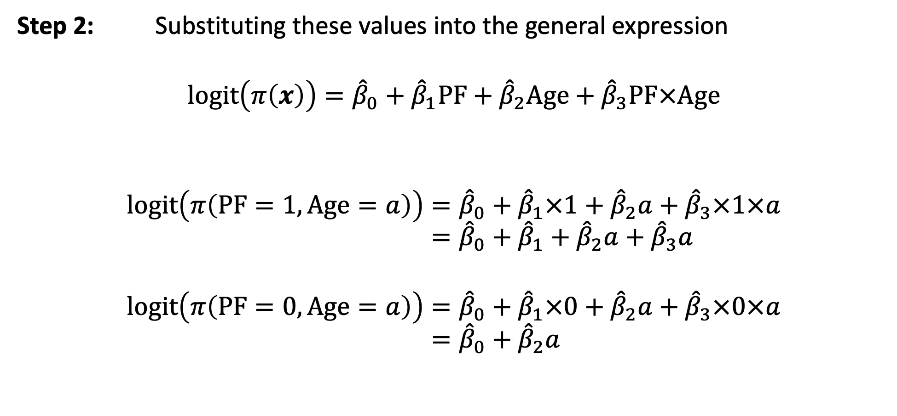
Example: GLOW – Step 2
Step 2: Substituting these values into the general expression
$$logit\left(π\left(x\right)\right)={\hat{β}}_{0}+{\hat{β}}_{1}PF+{\hat{β}}_{2}Age+{\hat{β}}_{3}PF×Age$$
$$logit\left(π\left(PF=1, Age=a\right)\right)={\hat{β}}_{0}+{\hat{β}}_{1}×1+{\hat{β}}_{2}a+{\hat{β}}_{3}×1×a \\ ={\hat{β}}_{0}+{\hat{β}}_{1}+{\hat{β}}_{2}a+{\hat{β}}_{3}a$$
$$logit\left(π\left(PF=0, Age=a\right)\right)={\hat{β}}_{0}+{\hat{β}}_{1}×0+{\hat{β}}_{2}a+{\hat{β}}_{3}×0×a \\ ={\hat{β}}_{0}+{\hat{β}}_{2}a$$
Originally from Class 9 Notes

Slide 10
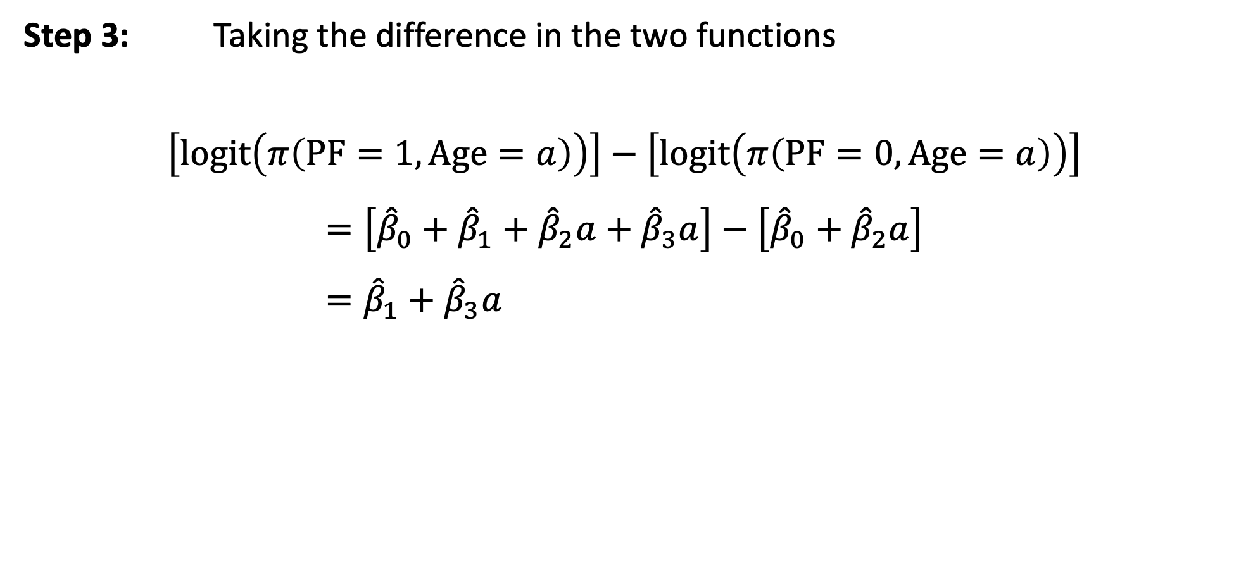
Example: GLOW – Step 3
Step 3: Taking the difference in the two functions
$$\left[logit\left(π\left(PF=1, Age=a\right)\right)\right]−\left[logit\left(π\left(PF=0, Age=a\right)\right)\right]$$
$$=\left[{\hat{β}}_{0}+{\hat{β}}_{1}+{\hat{β}}_{2}a+{\hat{β}}_{3}a\right]−\left[{\hat{β}}_{0}+{\hat{β}}_{2}a\right] \\ ={\hat{β}}_{1}+{\hat{β}}_{3}a$$
Originally from Class 9 Notes

Slide 11
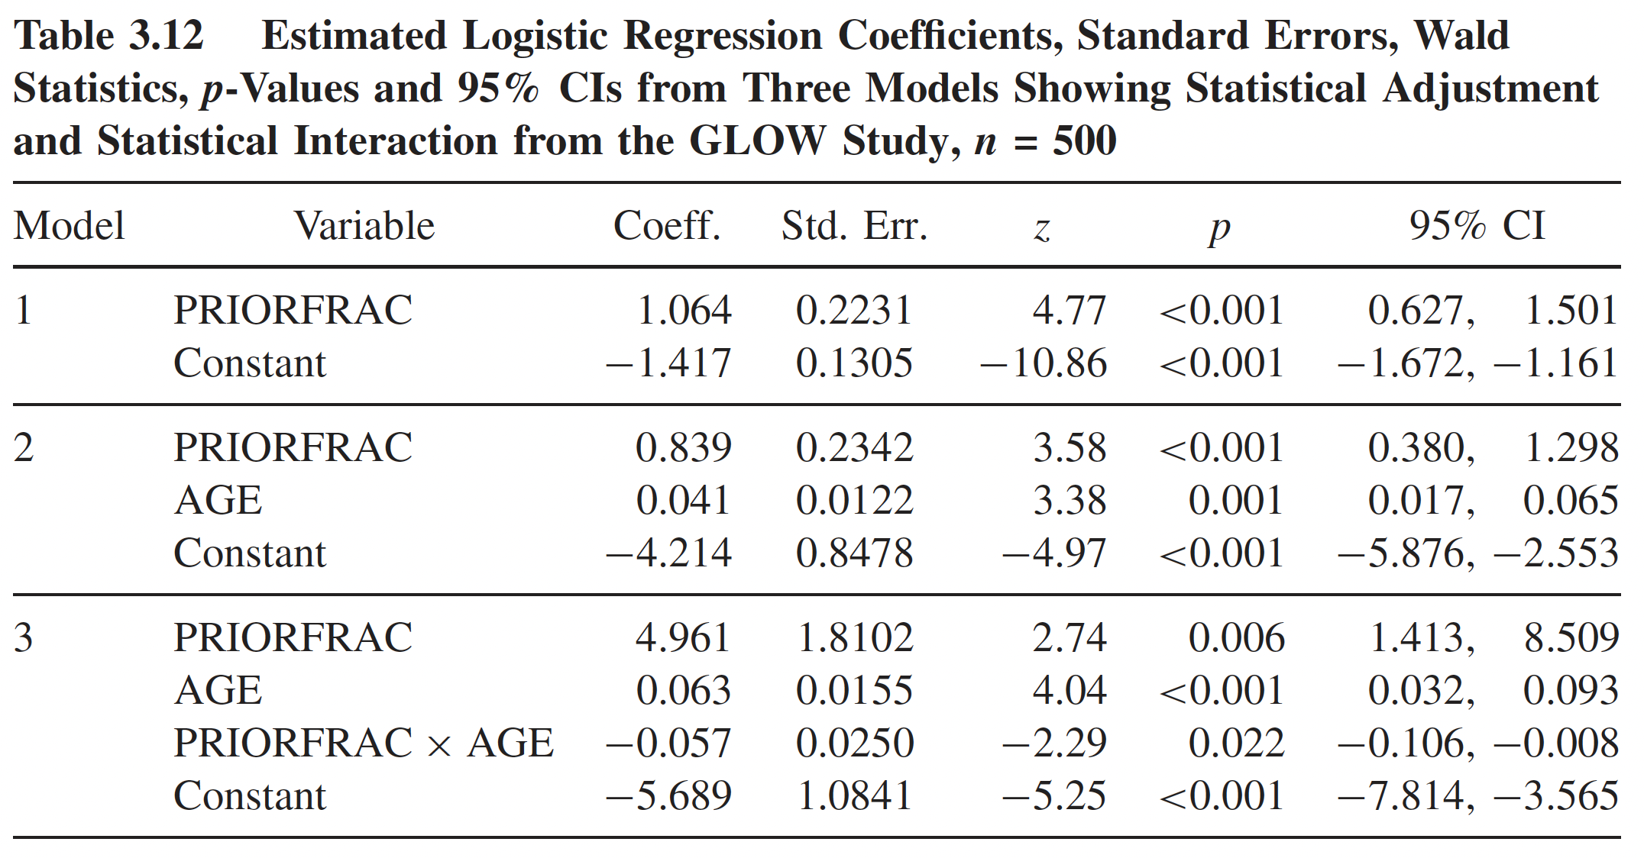
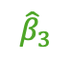
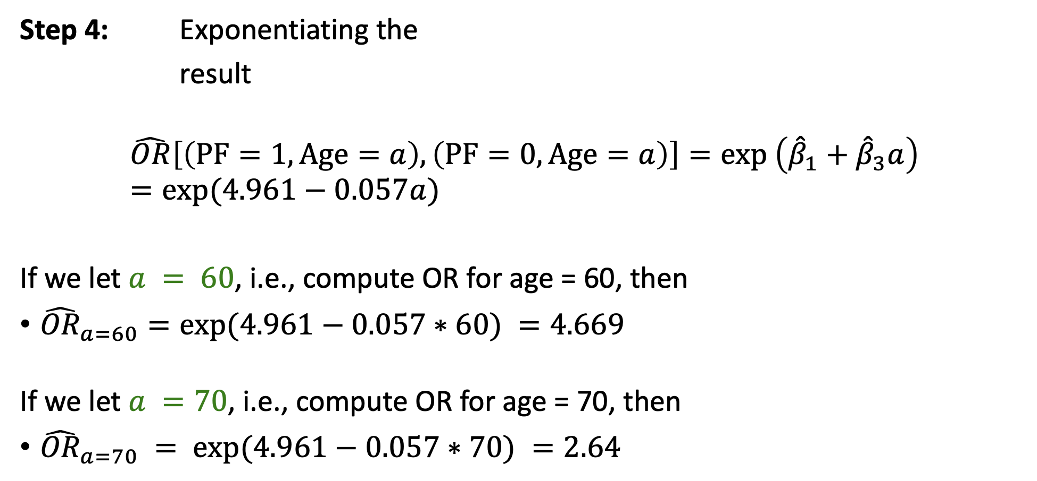
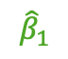
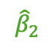

Example: GLOW – Step 4
Step 4: Exponentiating the
result
$$\hat{OR}\left[\left(PF=1, Age=a\right),\left(PF=0, Age=a\right)\right]=exp \left({\hat{β}}_{1}+{\hat{β}}_{3}a\right)=exp⁡(4.961−0.057a)$$
If we let $a = 60$, i.e., compute OR for age = 60, then
${\hat{OR}}_{a=60}=exp⁡(4.961−0.057∗60) =4.669$
If we let $a =70$, i.e., compute OR for age = 70, then
${\hat{OR}}_{a=70} = exp⁡(4.961−0.057∗70) =2.64$
$${\hat{β}}_{1}$$
$${\hat{β}}_{2}$$
$${\hat{β}}_{3}$$
$${\hat{β}}_{0}$$
Originally from Class 9 Notes

Slide 12
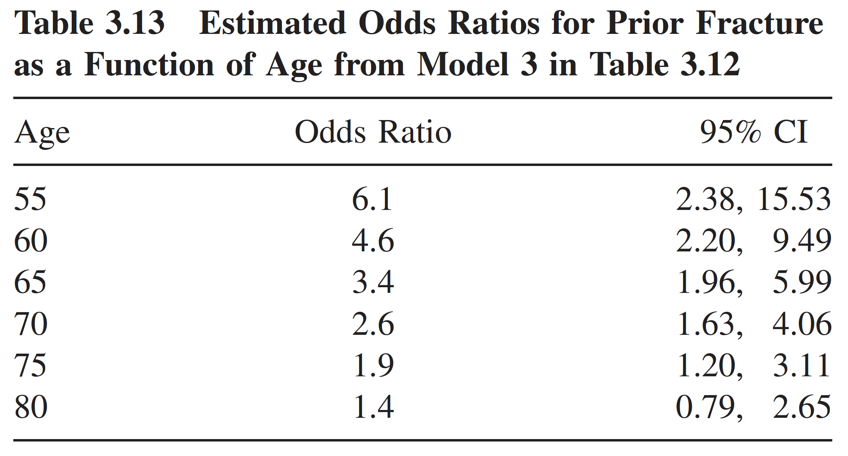
Example: GLOW – Table of ORs
Sometimes a Table listing the estimated odds ratio and 95% CI at different value of X will also be helpful and informative
Originally from Class 9 Notes
Table from Hosmer & Lemeshow, page 77

Slide 13
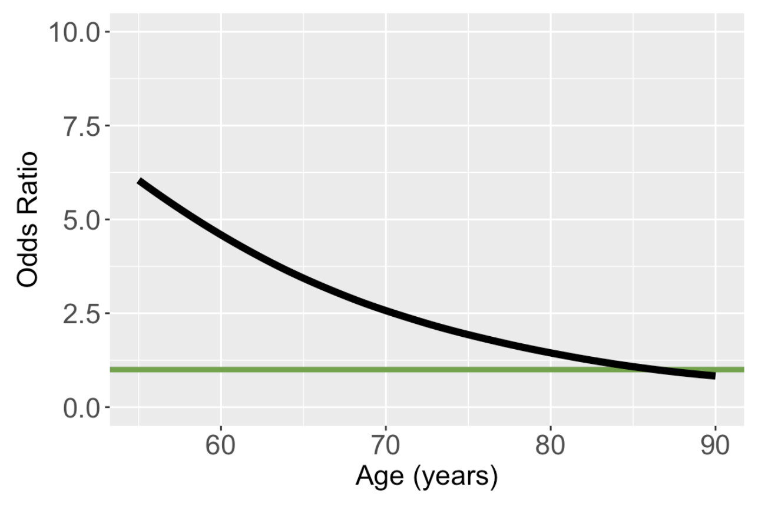
Plot of Odds Ratio Involving Interaction Term
Odds ratio comparing prior fracture to no prior fracture
Originally from Class 9 Notes

Slide 14
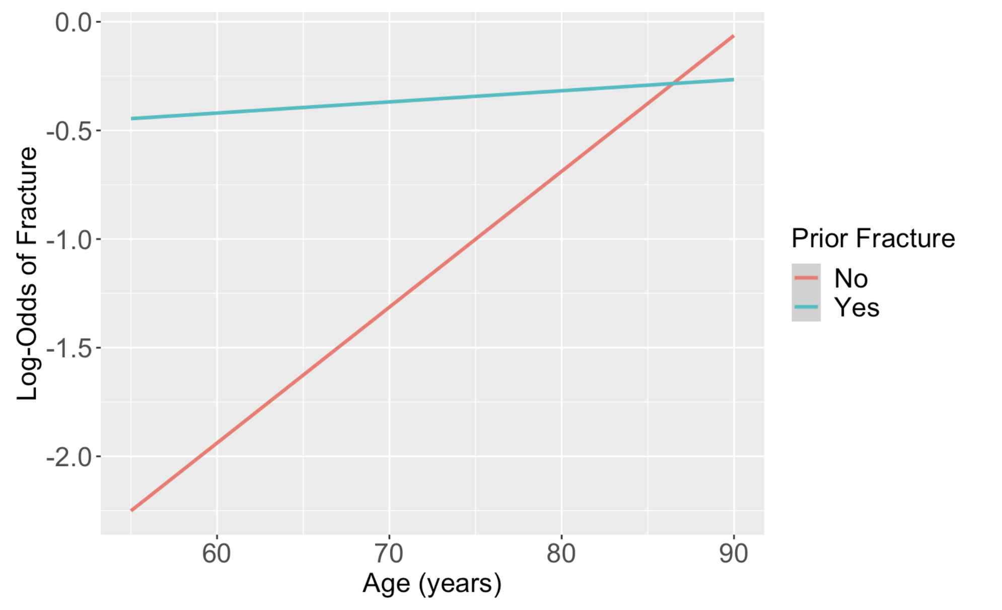
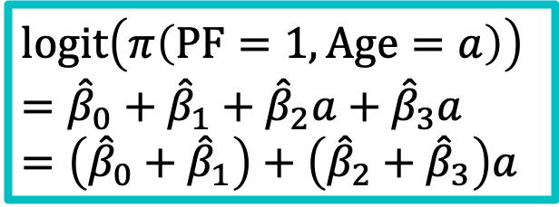
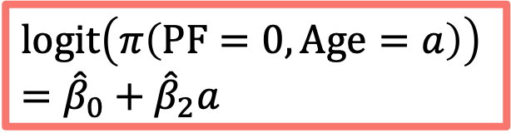
Graphically Showing Interaction Revisited
One easy way to see the nature of the interaction between F and X is to plot the two logit functions
Using the GLOW fracture example:
$$logit\left(π\left(PF=1, Age=a\right)\right)={\hat{β}}_{0}+{\hat{β}}_{1}+{\hat{β}}_{2}a+{\hat{β}}_{3}a=\left({\hat{β}}_{0}+{\hat{β}}_{1}\right)+\left({\hat{β}}_{2}+{\hat{β}}_{3}\right)a$$
$$logit\left(π\left(PF=0, Age=a\right)\right) \\ ={\hat{β}}_{0}+{\hat{β}}_{2}a$$
Originally from Class 9 Notes

Slide 15
Simple Poisson Regression

Slide 16
Poisson Distribution (I)
This distribution is often used to model count data
Examples:
Distribution of number of deaths due to lung cancer
Distribution of number of individuals diagnosed with leukemia
Distribution of number of hospitalizations

Slide 17
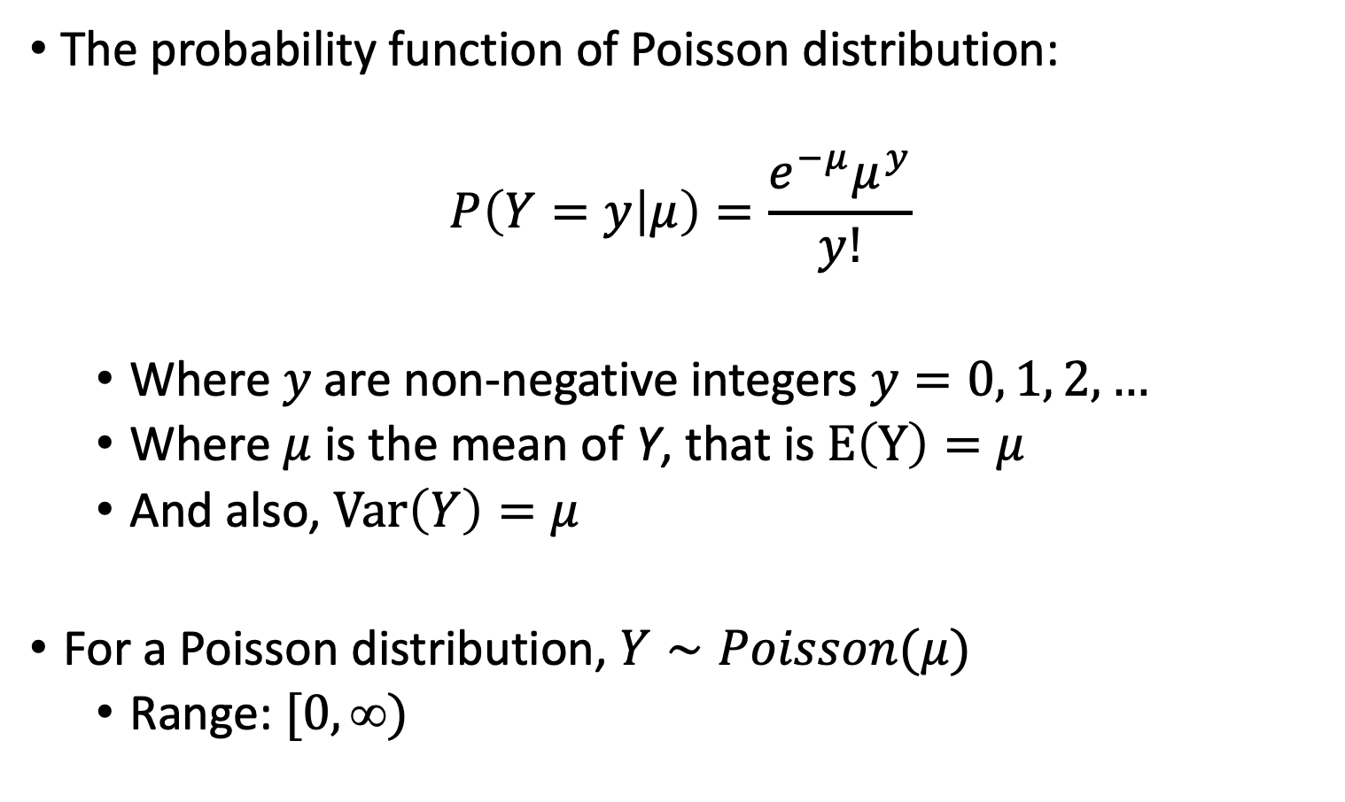
Poisson Distribution (II)
The probability function of Poisson distribution:
$$P\left(Y=y | μ\right)=\frac{e^{−μ}μ^{y}}{y!}$$
Where $y$are non-negative integers $y=0, 1, 2, …$
Where $μ$ is the mean of Y, that is $E\left(Y\right)=μ$
And also, $Var\left(Y\right)=μ$
For a Poisson distribution, $Y∼Poisson(μ)$
Range: $[0, )$

Slide 18
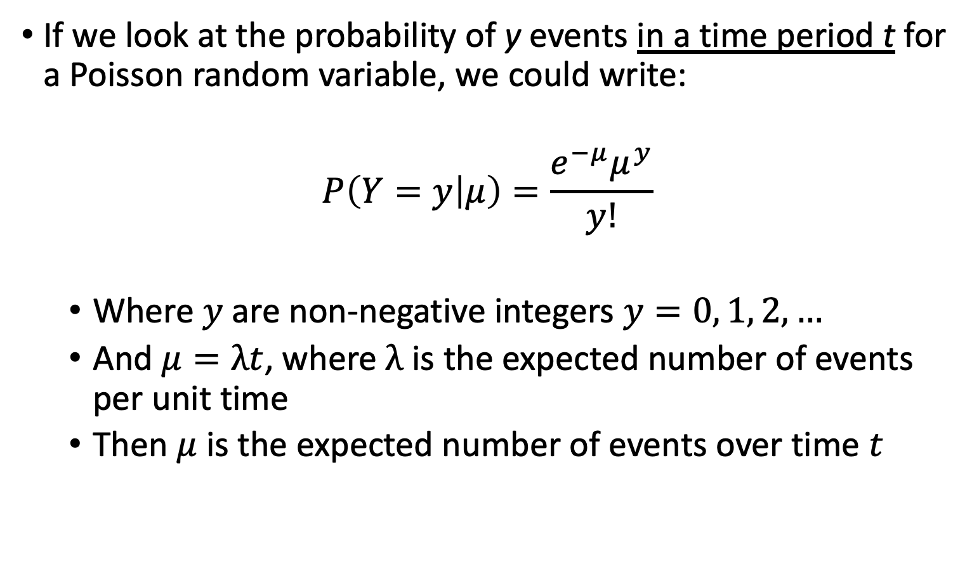
Poisson Distribution (III)
If we look at the probability of y events in a time period t for a Poisson random variable, we could write:
$$P\left(Y=y | μ\right)=\frac{e^{−μ}μ^{y}}{y!}$$
Where $y$are non-negative integers $y=0, 1, 2, …$
And $μ=λt$, where $λ$ is the expected number of events per unit time
Then $μ$ is the expected number of events over time $t$

Slide 19
Poisson Distribution (IV)
What does λ represent here?
A rate, the expected number of events in a given population over a given period time
Example: Number of patient arrivals into the Emergency Room per hour
The Poisson distribution is the prototype for assigning probabilities of observing any number of events

Slide 20
Poll Everywhere Question 1

Slide 21
Why Person-Years? (I)
In the example of number of patient arrivals, an event does not conclude the study
If someone arrives within the first minute of the study, then we keep counting
We may be able to study the association of arrivals with qualities of the hospital, but we can’t measure qualities of the individuals arriving
What happens if we want to measure qualities of the individual?
We can measure a hospitalization rate

Slide 22
Why Person-Years? (II)
If we are measuring at the individual level and counting something that is “terminal” then our count will always be 0 or 1
Example: Number of individuals diagnosed with leukemia
This only happens once, so how do we measure the rate here?
Since rate involves the counts and time – we can use the time to diagnosis to estimate the rate
Often expressed in units such as events per thousand person-years

Slide 23
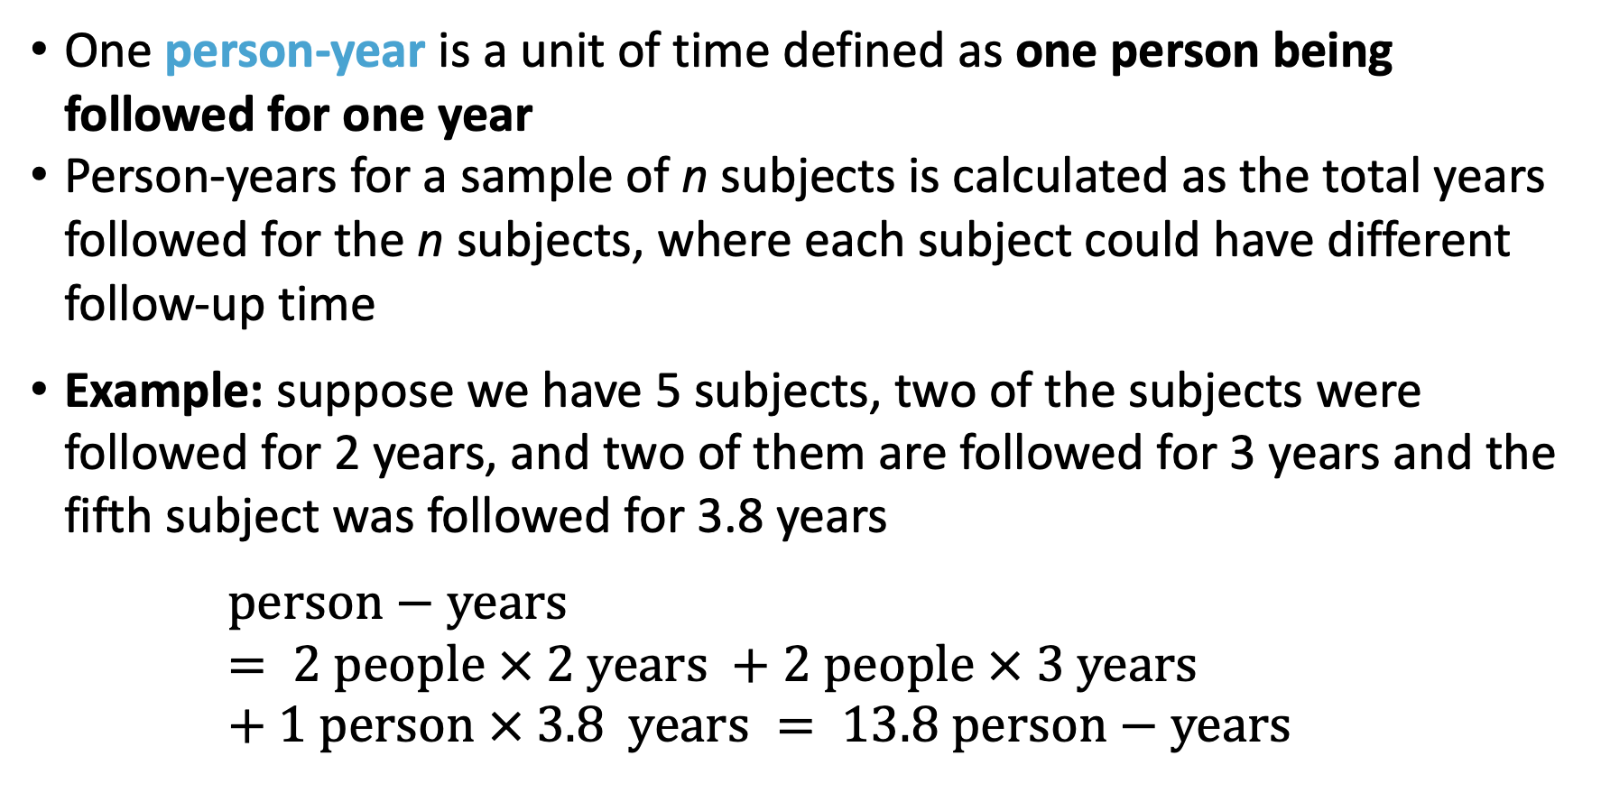
Calculating Person-Year
One person-year is a unit of time defined as one person being followed for one year
Person-years for a sample of n subjects is calculated as the total years followed for the n subjects, where each subject could have different follow-up time
Example: suppose we have 5 subjects, two of the subjects were followed for 2 years, and two of them are followed for 3 years and the fifth subject was followed for 3.8 years
$$person−years = 2 people × 2 years +2 people × 3 years+1 person × 3.8 years = 13.8 person−years$$

Slide 24
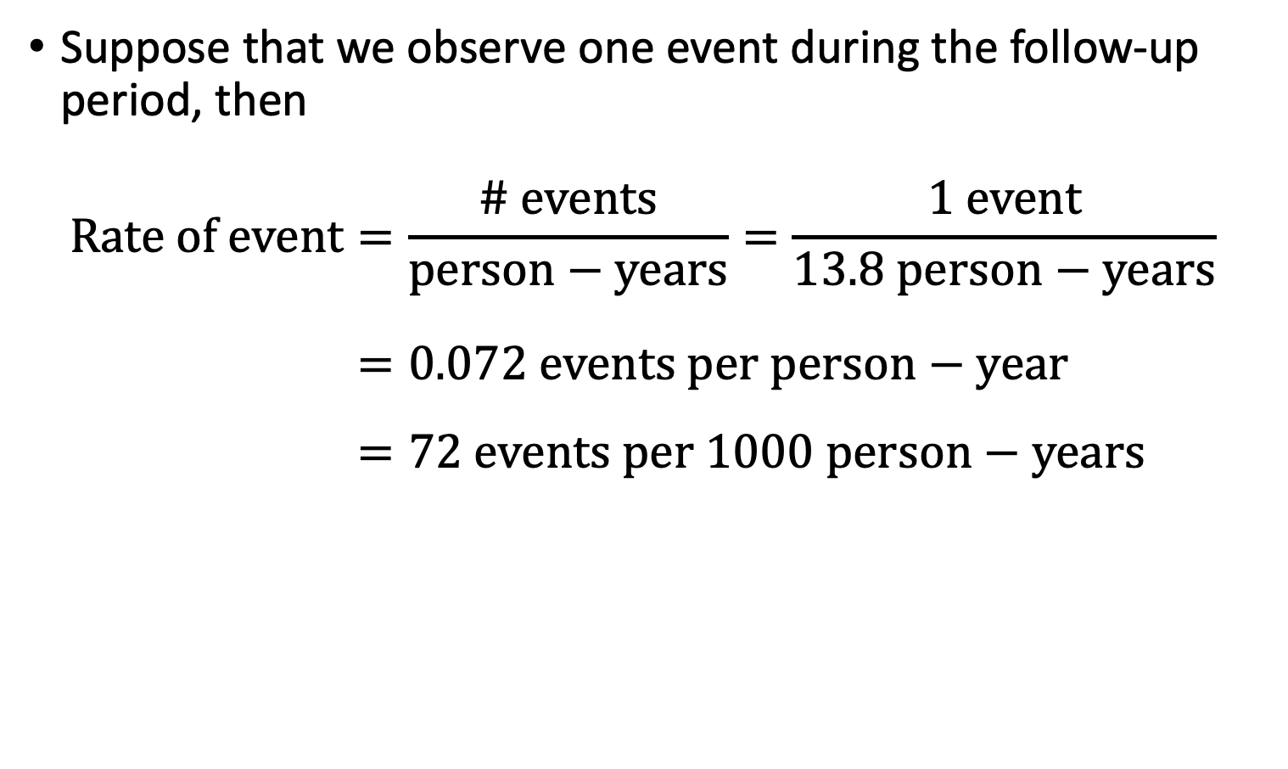
Calculating Rate (II)
Suppose that we observe one event during the follow-up period, then
$$Rate of event=\frac{\# events}{person−years}=\frac{1 event}{13.8 person−years} \\ =0.072 events per person−year \\ =72 events per 1000 person−years$$

Slide 25
Stop here?
If we do:
Good tutorial in R: https://www.dataquest.io/blog/tutorial-poisson-regression-in-r/

Slide 26
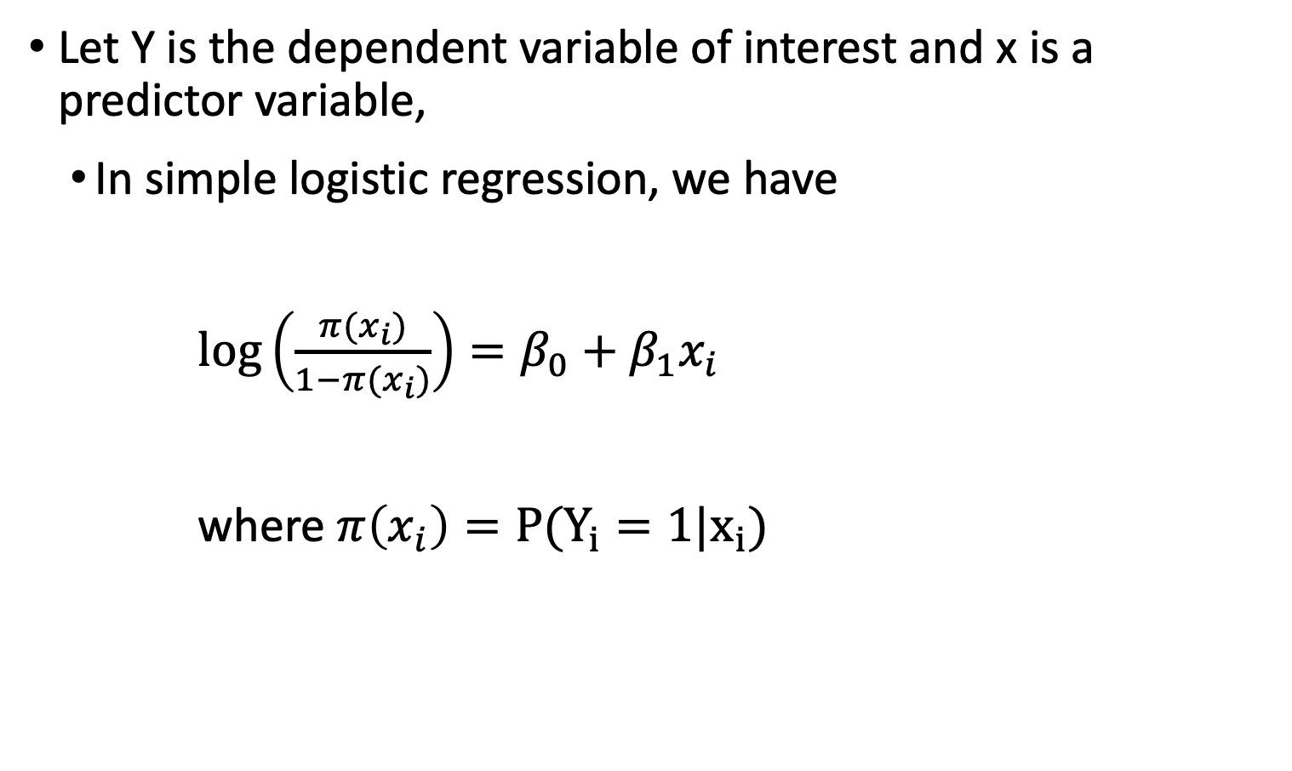
Review: Simple Logistic Regression
Let Y is the dependent variable of interest and x is a predictor variable,
In simple logistic regression, we have
$\log\left(\frac{π(x_{i})}{1−π(x_{i})}\right)=β_{0}+β_{1}x_{i}$
where $π\left(x_{i}\right)=P(Y_{i}=1|x_{i})$

Slide 27
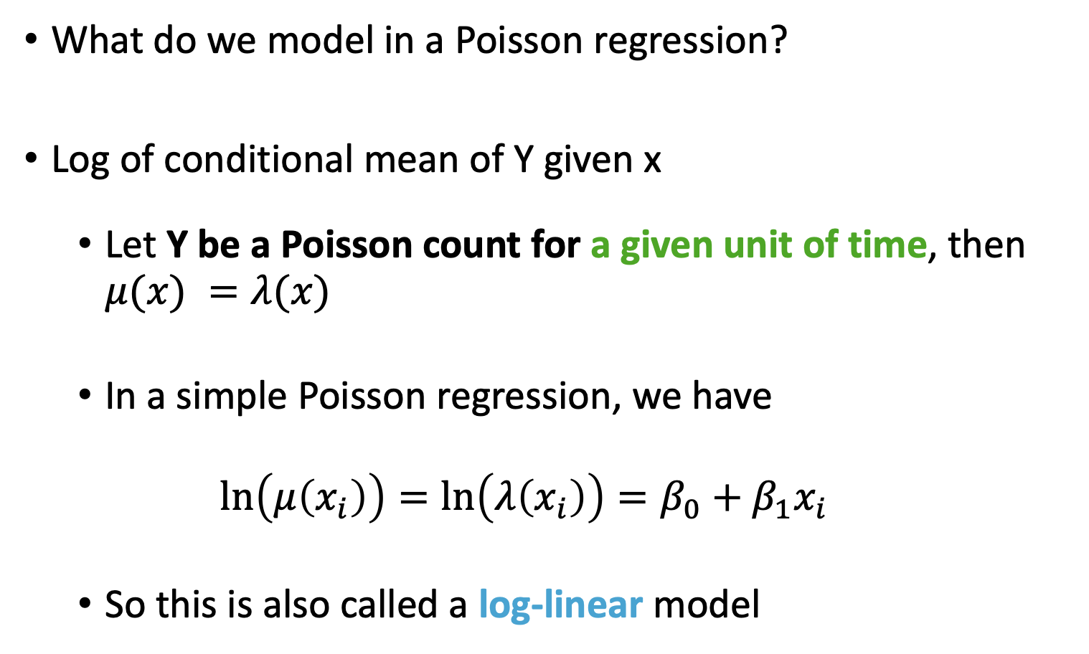
Simple Poisson Regression Model
What do we model in a Poisson regression?
Log of conditional mean of Y given x
Let Y be a Poisson count for a given unit of time, then $μ(x) =λ(x)$
In a simple Poisson regression, we have
$$\ln\left(μ\left(x_{i}\right)\right)=\ln\left(λ\left(x_{i}\right)\right)=β_{0}+β_{1}x_{i}$$
So this is also called a log-linear model

Slide 28
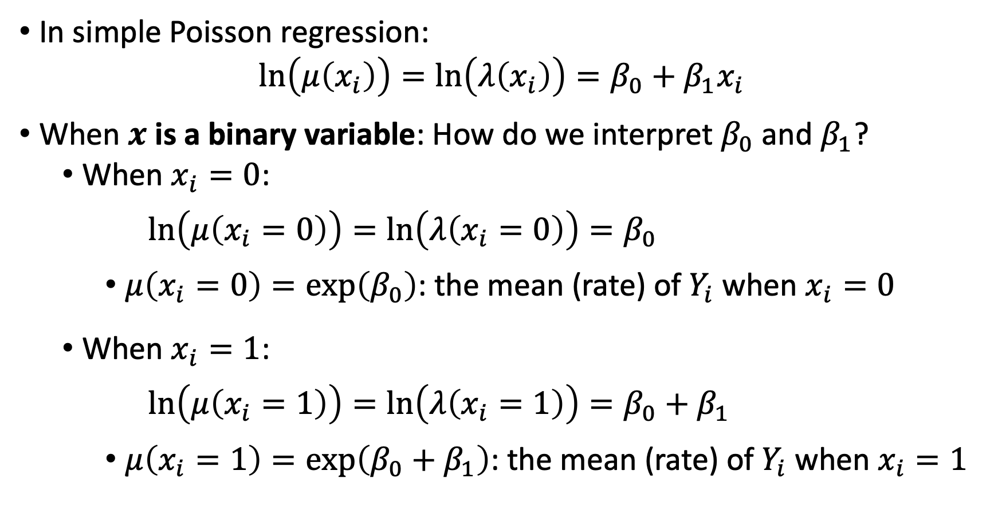
Parameter Interpretation (I)
In simple Poisson regression:
$$\ln\left(μ\left(x_{i}\right)\right)=\ln\left(λ\left(x_{i}\right)\right)=β_{0}+β_{1}x_{i}$$
When $x$ is a binary variable: How do we interpret $β_{0}$and $β_{1}$?
When $x_{i}=0$:
$$\ln\left(μ\left(x_{i}=0\right)\right)=\ln\left(λ\left(x_{i}=0\right)\right)=β_{0}$$
$μ\left(x_{i}=0\right)=exp\left(β_{0}\right)$: the mean (rate) of $Y_{i}$ when $x_{i}=0$
When $x_{i}=1$:
$$\ln\left(μ\left(x_{i}=1\right)\right)=\ln\left(λ\left(x_{i}=1\right)\right)=β_{0}+β_{1}$$
$μ\left(x_{i}=1\right)=exp\left(β_{0}+β_{1}\right)$: the mean (rate) of $Y_{i}$ when $x_{i}=1$

Slide 29
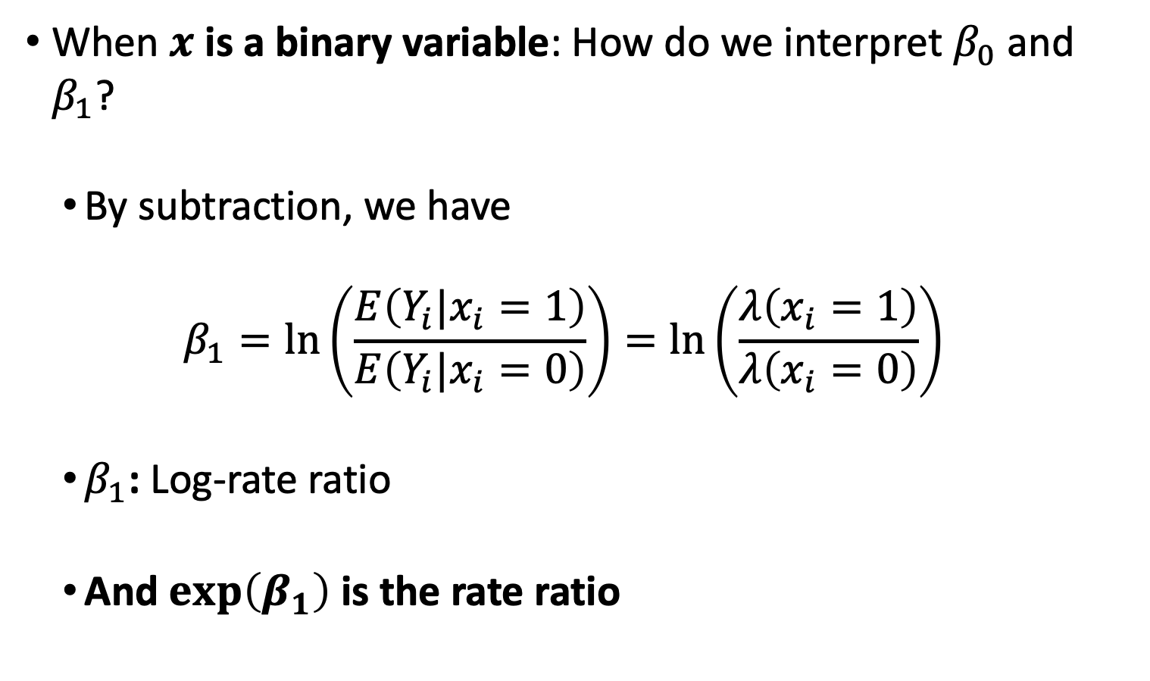
Parameter Interpretation (II)
When $x$ is a binary variable: How do we interpret $β_{0}$and $β_{1}$?
By subtraction, we have
$$β_{1}=\ln\left(\frac{E\left(Y_{i}|x_{i}=1\right)}{E\left(Y_{i}|x_{i}=0\right)}\right)=\ln\left(\frac{λ\left(x_{i}=1\right)}{λ\left(x_{i}=0\right)}\right)$$
$β_{1}$: Log-rate ratio
And $\exp\left(β_{1}\right)$ is the rate ratio

Slide 30
Further reading / tutorials on Poisson regression
Good tutorial in R: https://www.dataquest.io/blog/tutorial-poisson-regression-in-r/
When people are followed for different amounts of time, we should include an offset
Poisson Regression Modeling Using Rate Data: section from above site that discusses offsets
We can use Wald test and LRT in the same way as logistic regression to test our coefficients and variables

Slide 31
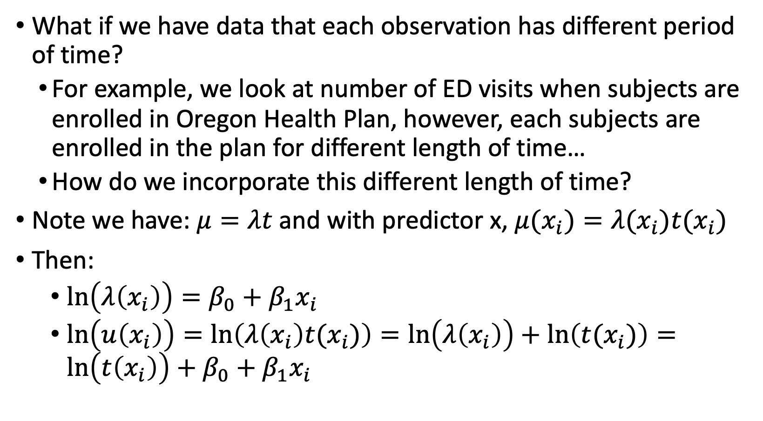
Model Construction – Include Offset (I)
What if we have data that each observation has different period of time?
For example, we look at number of ED visits when subjects are enrolled in Oregon Health Plan, however, each subjects are enrolled in the plan for different length of time…
How do we incorporate this different length of time?
Note we have: $μ=λt$ and with predictor x, $μ(x_{i})=λ(x_{i})t(x_{i})$
Then:
$\ln\left(λ\left(x_{i}\right)\right)=β_{0}+β_{1}x_{i}$
$\ln\left(u\left(x_{i}\right)\right)=\ln\left(λ\left(x_{i}\right)t(x_{i})\right)=\ln\left(λ\left(x_{i}\right)\right)+\ln\left(t(x_{i})\right)=\ln\left(t\left(x_{i}\right)\right)+β_{0}+β_{1}x_{i}$

Slide 32
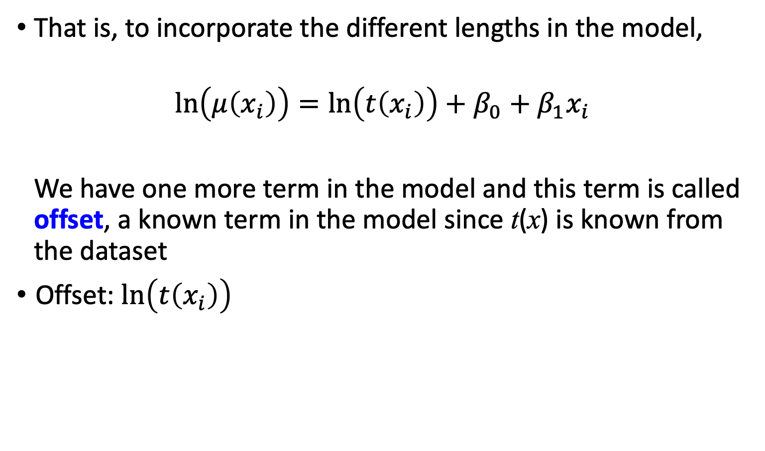
Model Construction – Include Offset (II)
That is, to incorporate the different lengths in the model,
$$\ln\left(μ\left(x_{i}\right)\right)=\ln\left(t\left(x_{i}\right)\right)+β_{0}+β_{1}x_{i}$$
We have one more term in the model and this term is called offset, a known term in the model since t(x) is known from the dataset
Offset: $\ln\left(t\left(x_{i}\right)\right)$

Slide 33
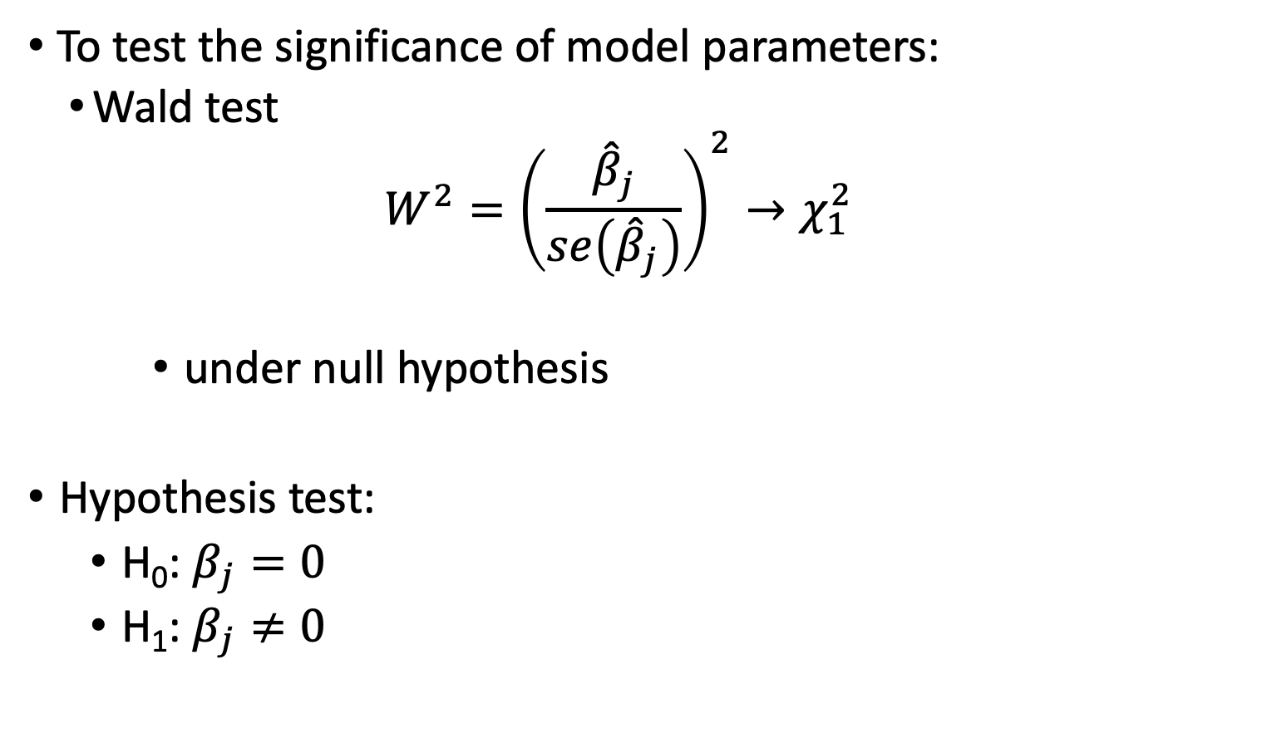
Test for Significance in Parameter (I)
To test the significance of model parameters:
Wald test
$$W^{2}={\left(\frac{{\hat{β}}_{j}}{se\left({\hat{β}}_{j}\right)}\right)}^{2}→χ_{1}^{2}$$
under null hypothesis
Hypothesis test:
H₀: $β_{j}=0$
H₁: $β_{j}≠0$

Slide 34
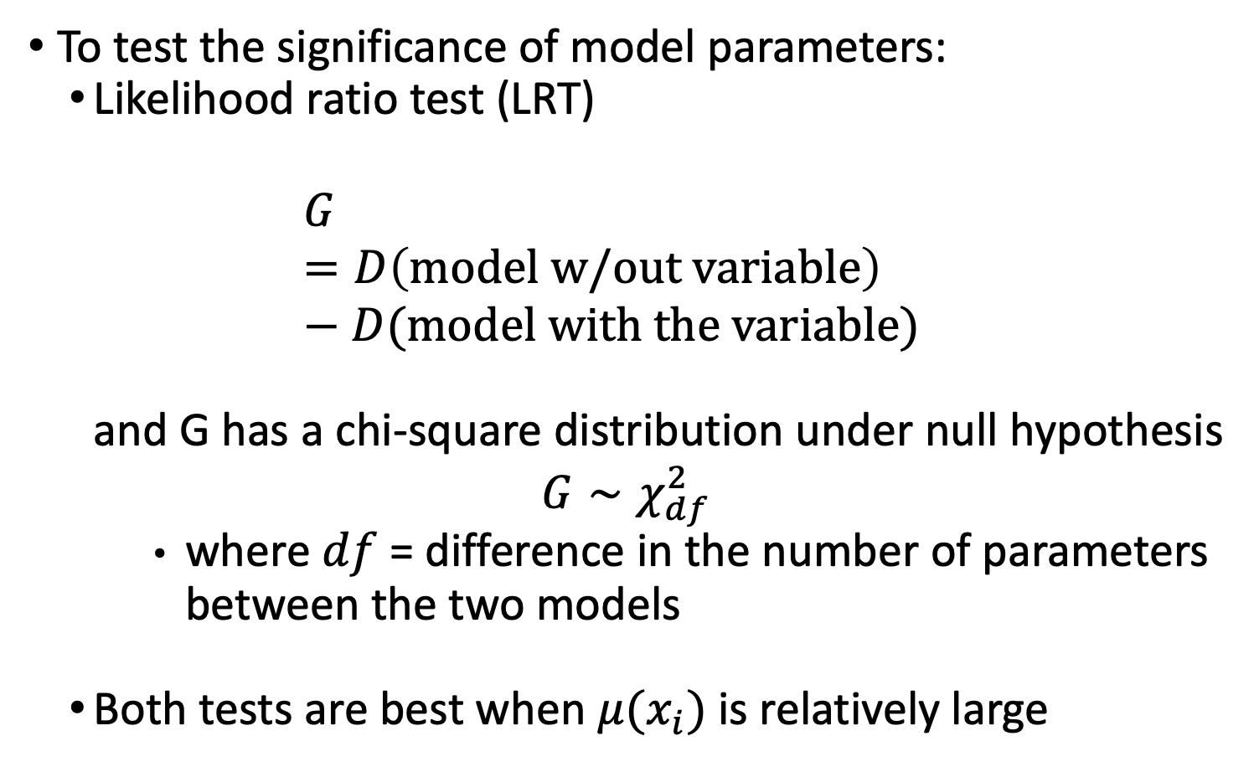
Test for Significance in Parameter (II)
To test the significance of model parameters:
Likelihood ratio test (LRT)
$$G=D\left(model w/out variable\right)−D(model with the variable)$$
and G has a chi-square distribution under null hypothesis
$$G∼χ_{df}^{2}$$
where $df$ = difference in the number of parameters between the two models
Both tests are best when $μ(x_{i})$is relatively large

Slide 35

Wrap-up
4-minute exit ticket
Thanks for a great quarter!
https://forms.office.com/r/5q7YxDi58s

